Slide 1

Team 7
HEINEKEN CASE STUDY
MKT 562 – Advanced Marketing Analytics
Date : 2/10/2025,
Group Members:
Ayush Trivedi, Dhruv Shah, Kushal Patel, Neil Dilawari,
Sukanya Mane, Sravani Bolla, Tejaswini Nannapaneni

Slide 2


TABLE OF CONTENT
Introduction
Heineken’s market in Spain
Spain’s Beer Market Overview
Consumer Preferences & challenges
The food + beer equation
Survey Results
Three Strategic Alternatives
Enginius Analysis - Dimension Introduction
Preferences Analysis
Market share Analysis
Choosing the best Alternative
Steps to reposition & recommendation

Slide 3
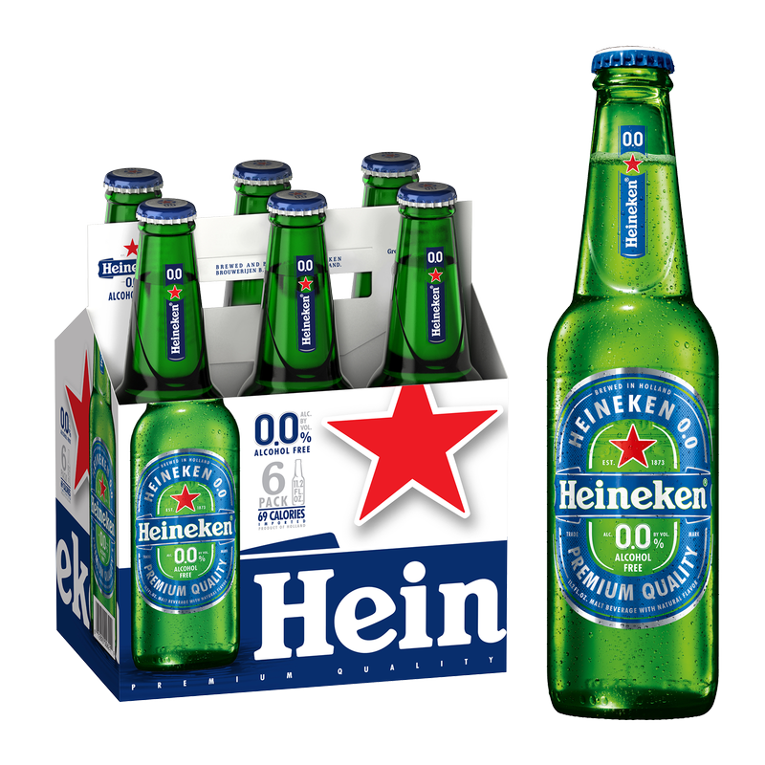
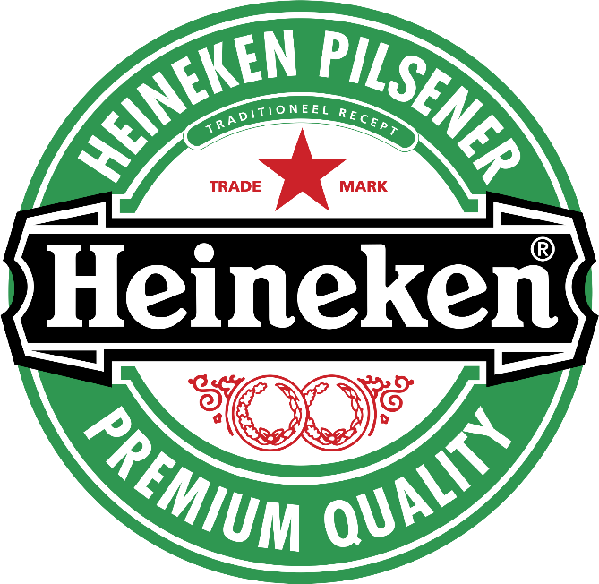
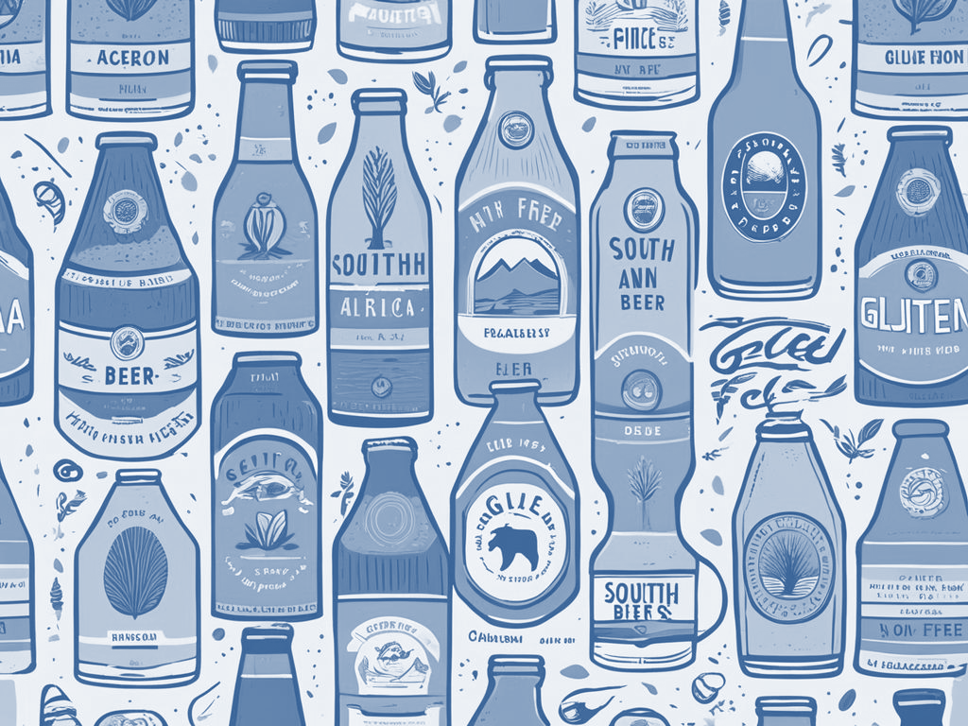
Introduction
One of the world’s largest beer companies, known for its premium lager positioning
Founded in 1873 in the Netherlands, expanding globally
Entered Spain in 1984 by acquiring El Águila Brewery
Acquired Cruzcampo (Diageo subsidiary) in 1999, becoming #1 player in Spain

Slide 4

Adrien Tremblay – The Decision Maker Regional
President of Western Europe at HNV
Has a strong background in sales, marketing, and consumer behavior
Tasked with identifying the right strategic move for Heineken in Spain
Three alternatives:
Maintain Heineken’s premium positioning
Reposition Heineken to better fit Spanish preferences
Realign HNV’s portfolio (Amstel, Cruzcampo)

Slide 5
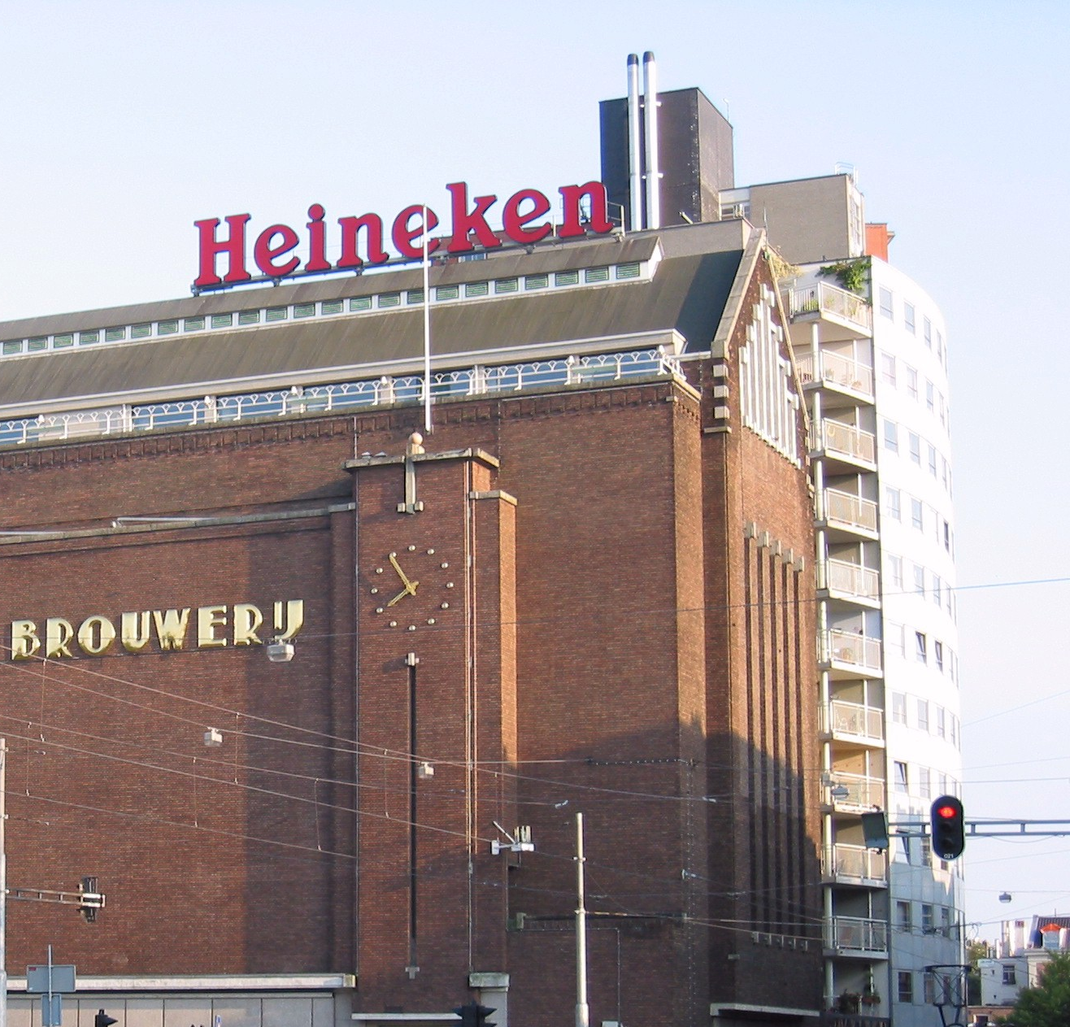
Heineken’s Brand Portfolio in Spain:
Heineken: Premium lager
Amstel: Fun, casual beer for everyday drinking
Cruzcampo: Strong local presence, especially in Southern Spain
Buckler: Non-alcoholic beer targeting health-conscious consumers
Key competitors in Spain:
Mahou: #1 domestic beer, very strong in Madrid
Cruzcampo: #1 domestic brand overall, competing within HNV itself
Estrella Damm: Popular in Barcelona, widely known for nightlife
San Miguel: Affordable, strong market presence
Carlsberg, Coronita (Corona), Budweiser: International competitors
Heineken’s Market in Spain

Slide 6
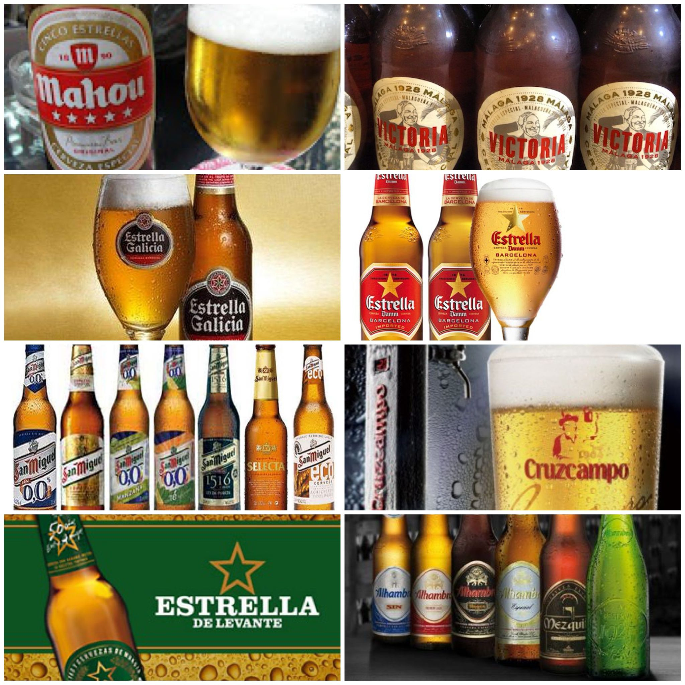
Spain’s Beer Market Overview
Spain has traditionally been a wine-drinking country
Beer market is growing, but consumption patterns are different from other countries
Major beer segments in Spain:
Standard (Pale) Lager: Light, smooth, affordable (Mahou, Cruzcampo, San Miguel)
Premium Lager: Higher-quality, more expensive (Heineken, Carlsberg)
Ales, Stouts & Bitters: Small segment, unfamiliar to Spanish consumers
Specialty Beers: Seasonal and flavored beers, niche market
Low/Non-Alcoholic Beers: Growing due to health-conscious trends (Buckler, Heineken 0.0)

Slide 7
Consumer Preferences & Challenges
1. Low Beer Consumption Culture in Spain
3. Economic Challenges
Recession → Price-sensitive consumers
Premium beer sales are stagnating
Cheaper private-label brands are gaining market share
Wine is dominant – beer is still growing
Spaniards prefer lighter, easy-to-drink beers
2. Changing Preferences
4. Brand Positioning Issues
Rising health consciousness → Growth of low/non-alcoholic beers
Demand for lighter, less bitter beers
More home consumption, fewer restaurant/bar visits
Heineken is seen as too expensive and exclusive
Mahou & Cruzcampo are better positioned as affordable, everyday beers

Slide 8
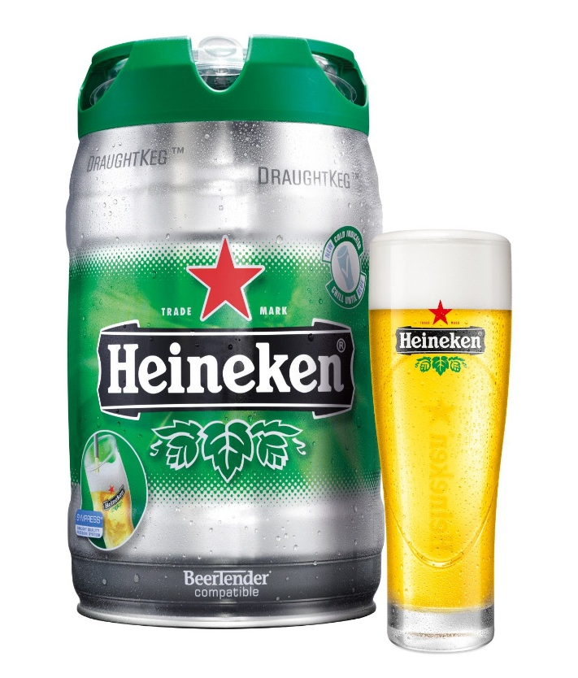
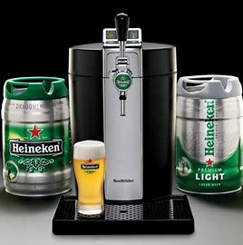
The Food + Beer Equation
Heineken tried to position beer as a meal companion, but wine dominates
Marketing Efforts to Promote Beer-Food Pairing:
DraughtKeg & BeerTender → For home drinking & hosting
La Amstelería Beer Bars → Integrated beer with dining, limited success
Madrid Xanadu Mall (200+ eateries) → Controlled restaurant experience to promote beer
Draught keg
Beer Tender

Slide 9


Survey Results
Understanding Spanish Consumers and to gain insights, Heineken conducted a large-scale consumer survey:
Conducted by Xplore Consulting
1,123 consumers across 6 regions
Survey collected:
Demographics
Beer consumption patterns
Brand awareness
Perception of key attributes (taste, quality, affordability, etc.)
Preference ratings for major beer brands

Slide 10
Survey Results
- Key Findings
Consumer Perceptions:
Consumer Preferences by Region:
Consumer Preferences by Segment
Heineken is perceived as: Premium, modern, high quality, but too expensive
Cruzcampo & Mahou are seen as: Affordable, easy-to-drink, everyday beers
Younger consumers prefer: Smoother, lighter beers over bitter ones
Heineken is NOT associated with food pairing (unlike wine)
Madrid & Northern Spain → Mahou is dominant
Southern Spain → Cruzcampo is strongest
Heineken has inconsistent appeal across different regions
Segment P1-P4 (Older consumers) : Strong preference for Heineken & premium beers
Segment P5-P9 (Younger consumers) : More inclined towards affordable, domestic beers

Slide 11
Three(3) Strategic Alternatives
1. Maintain Current Positioning
2. Reposition Heineken
3. Realign the HNV Portfolio
Stays true to Heineken’s premium brand identity
Limited growth potential in Spain’s price-sensitive market
Targets younger consumers & home drinkers
Makes Heineken more approachable
Risk of brand dilution – losing premium identity
Use Amstel & Cruzcampo to compete with Mahou
Preserve Heineken’s premium image
Expand into low-alcohol & home-friendly beer options

Slide 12
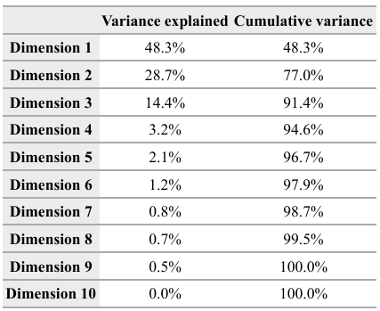
Enginius Analysis
Understanding the Dimensions in Perceptual Mapping
Dimension 1 - Price vs. Value Perception (Expensive vs. Value-for-Money)
Dimension 2 - Taste & Smoothness (Easy-to-Drink, Refreshing, Bitter)
Dimension 3 - Brand Image & Social Context (Nightclub, Everyday/Home
Key Insight:
The first two dimensions explain 77% of the total variance in the data.
The third dimension adds another 14.4%, making the analysis 91.4% accurate.
Table of Variance Explained for Each Dimension

Slide 13
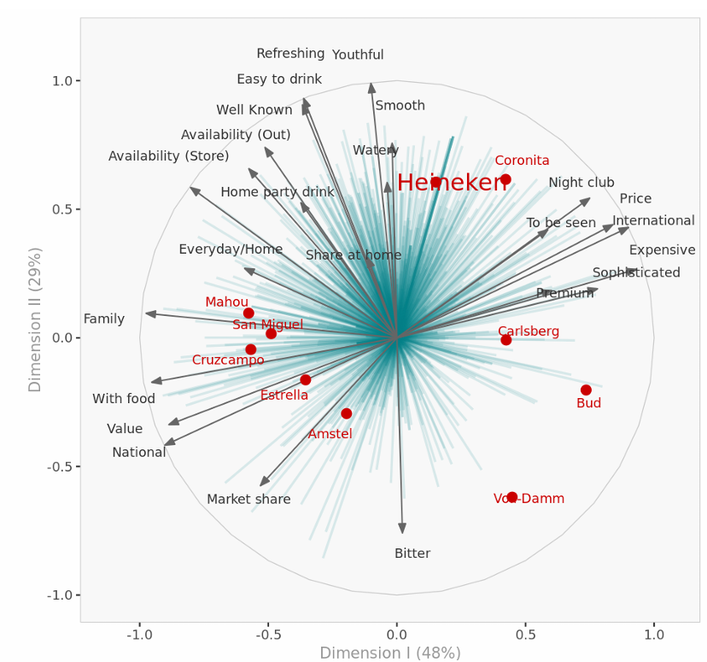
Preferences Analysis - Perceptual Map
Dimension I: Social/emotional connection (48% of variance).
Dimension II: Practical/personal use (29% of variance).
Heineken’s Position: Premium, sophisticated, international, ideal for nightclubs/parties.
Competitors:
Coronita: Balances premium with “easy to drink, refreshing” attributes.
Mahou/Cruzcampo: Practical appeal for everyday/home use.
Opportunity: Leverage Heineken’s premium brand equity while addressing the “easy-to-drink” and “everyday use” gap.
Perceptual Map I-II

Slide 14
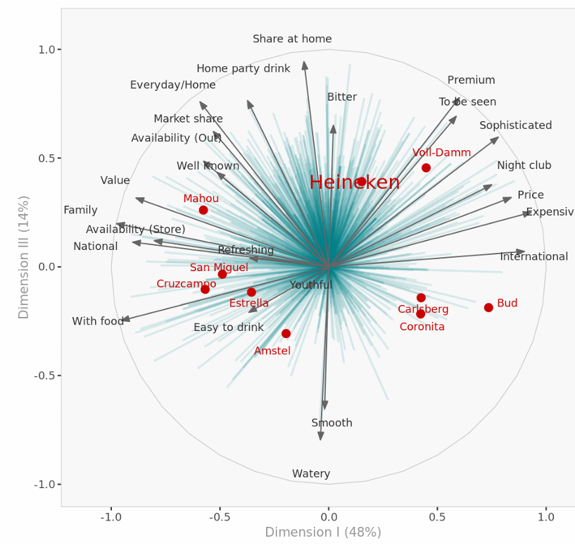
Preferences Analysis - Perceptual Map
Dimension I, Social/Emotional (48%): Premium, Sophisticated
Dimension III,Practical/Personal (14%): Everyday, Refreshing
Heineken: Premium, International, Nightclub, Expensive
Competitors:
Coronita: Premium, Easy-Drinking, Youthful
Mahou/Cruzcampo: Everyday, Home, Family
Opportunity: Extend brand to "easy-drink" and "everyday" markets
Perceptual Map I-III

Slide 15
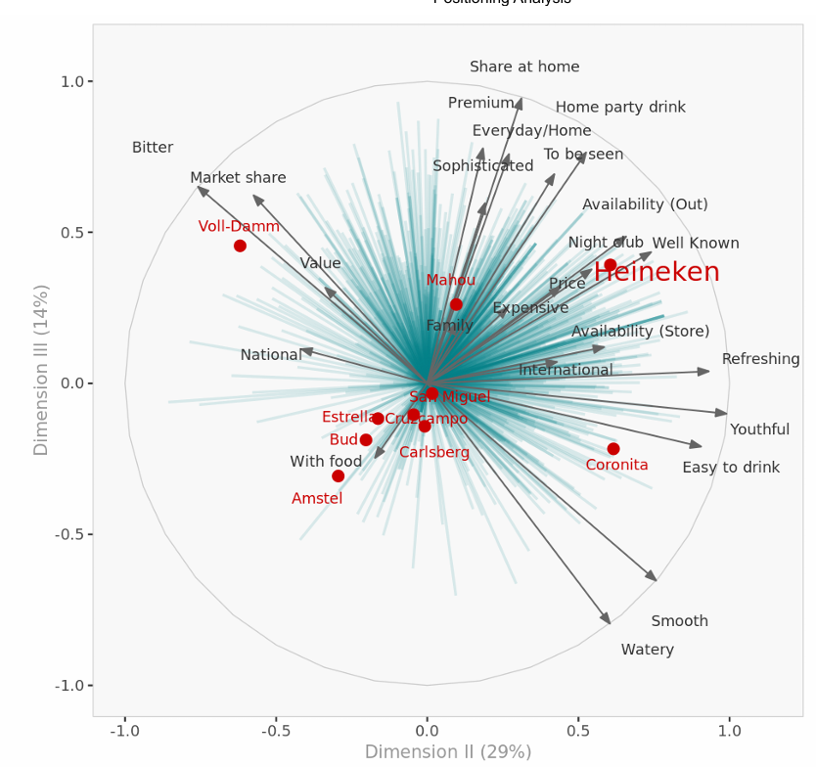
Preferences Analysis - Perceptual Map
Dimension II: Social/Emotional (48% - previously noted, but not on this chart): Premium, Sophisticated
Dimension III: Practical/Personal (29%): Everyday, Refreshing, Easy-Drinking
Heineken’s Position: Premium, International, Nightclub, Expensive
Competitors:
Coronita: Premium, Easy-Drinking, Youthful
Mahou: Everyday, Family-Oriented
Voll-Damm: Value-Driven
Opportunity: Extend Heineken to broader occasions, balancing premium with accessibility.
Perceptual Map II-III
Repositioning Heineken towards social, everyday beer segment ,easy-to-drink attributes could drive higher preference.

Slide 16
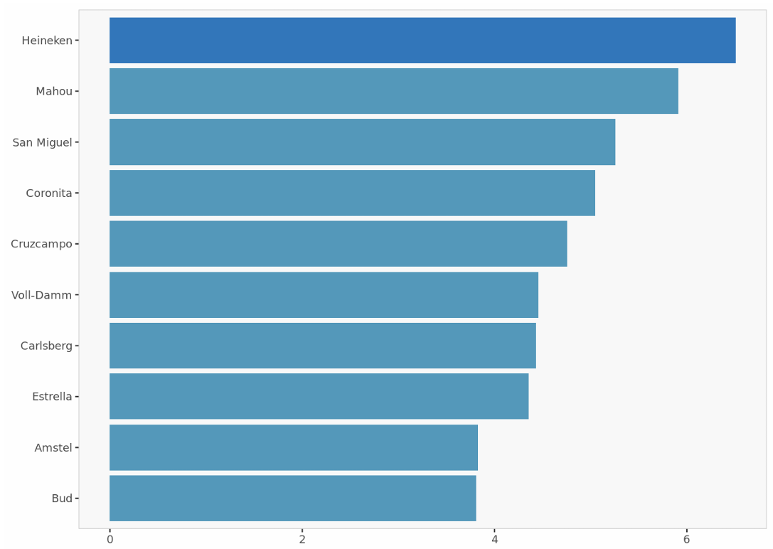
Average Preference
The bar chart displays a ranking of beer brands (Heineken, Mahou, San Miguel, Coronita, Cruzcampo, Voll-Damm, Carlsberg, Estrella, Amstel, and Bud) based on an unspecified metric, likely related to market share, sales volume, or perhaps brand preference.
Heineken leads significantly, followed by Mahou, while the remaining brands show a more gradual decline in the measured metric, with Bud at the bottom.
The gradient color scheme from dark to light blue may visually suggest a descending order of quality or importance, though this is not explicitly stated.

Slide 17
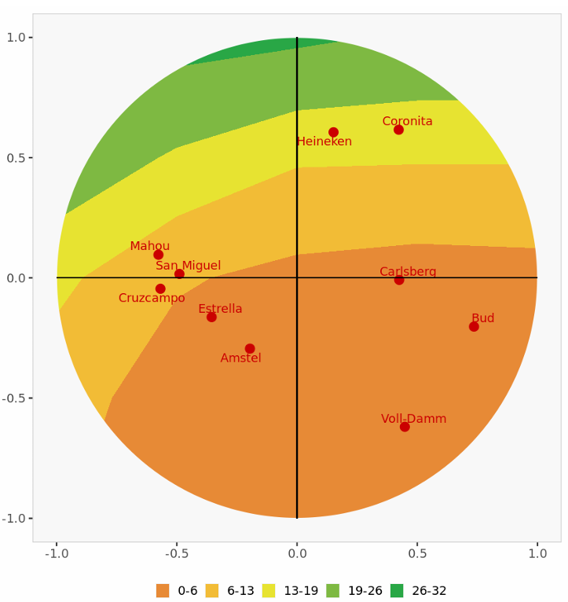
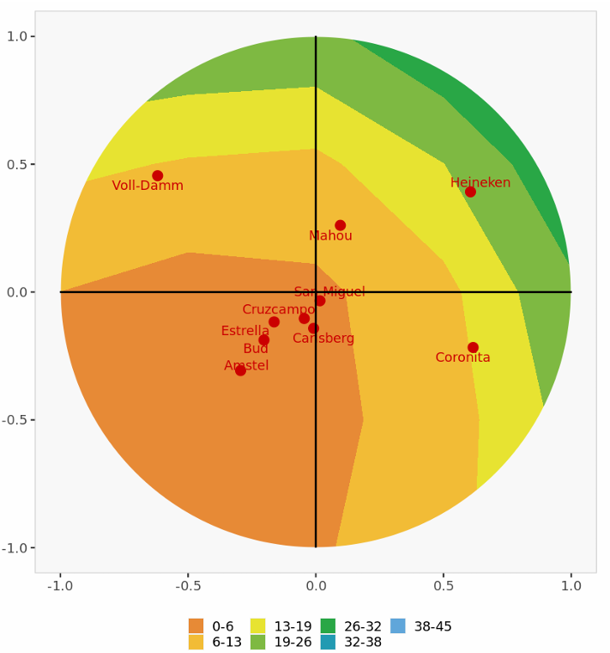
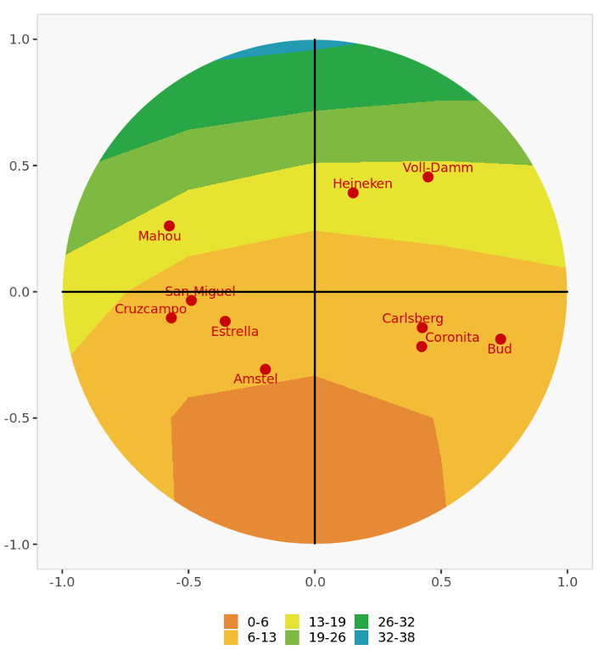
Market Share Analysis
Dimension I-II
Dimension II-III
Dimension I-III
To broaden appeal, Heineken needs to balance its premium image with more accessible pricing and marketing, targeting younger consumers and everyday occasions.
Dimensions 1 & 2: Heineken and Carlsberg are most similar, both high on both dimensions. Coronita is related but less so, Mahou differs on Dimension 1.
Dimensions 2 & 3: Mahou is Heineken's closest competitor. Coronita is close on 2 but different on 3. Voll-Damm is also a competitor.
Dimensions 1 & 3: Voll-Damm is Heineken's closest competitor. Mahou and Coronita have distinct profiles.

Slide 18
Choosing the Best Strategic Alternative
Maintain Current Position:
Reposition Heineken:
Portfolio Strategy:
Let Cruzcampo & Amstel compete directly with Mahou for the mass market.
Keep Heineken premium but adjust messaging to make it more relatable.
Invest in low-alcohol beer segment to capture health-conscious consumers.
Keeps Heineken’s premium brand image.
Limits market expansion, as Spanish consumers prefer local, affordable brands.
Focus on value-for-money, emphasize refreshing taste.
Target younger consumers via experiential marketing (e.g., music festivals, influencer marketing).
Promote Heineken as a socializing drink rather than just a premium beer.
Repositioning Heineken + Strengthening Portfolio (Option 2 & 3) is the best approach.

Slide 19
Steps to Reposition
Final Recommendation:
Consumer Perceptions:
Short-Term Actions (Next 6 Months):
Launch targeted marketing emphasizing Heineken as a refreshing, social beer.
Introduce limited-time discounts & promotions.
Increase digital & influencer marketing campaigns.
Adjust Marketing Focus: Highlight social, easy-to-drink aspects rather than just premium pricing.
Target Younger Consumers: Use music festivals, influencer marketing, and social media campaigns.
Retail Expansion: Offer discounts in grocery stores, increase promotions in bars & restaurants.
Introduce Low-Alcohol Options: Align with health-conscious trends in Spain.
Long-Term Strategy (Next 1-2 Years):
Strengthen Heineken’s perception as an everyday premium beer.
Expand presence in bars, nightclubs, and social events.
Reinforce Cruzcampo & Amstel to compete with Mahou for the mass-market segment.
Key Insight: The focus should be on making Heineken more approachable while retaining premium status.
Heineken should reposition itself as an easy-to-drink, premium-yet-accessible beer to increase market share.

Slide 20
THANK YOU!

